Slide 1




TPG 1 - Case Study
"Economies of scale and hospitals in Scotland"
Basic Economics for Sustainable Industrial Engineering (M1 SIE)
AWADA, Tala
CRISTALDO, Liz
FIRDAUS, Syamsi
LARA, Oswaldo
October 8th, 2020

Slide 2

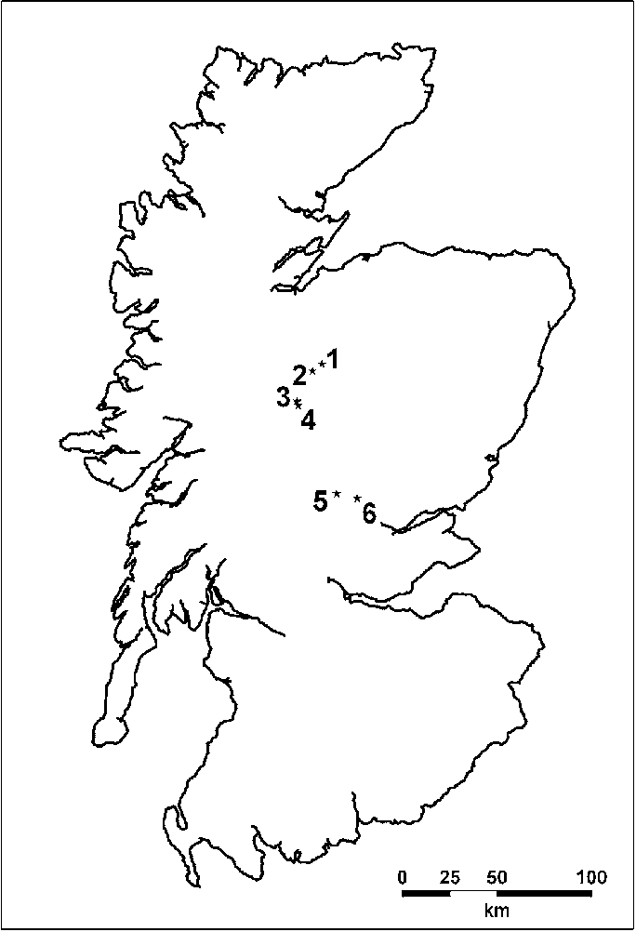
Introduction of the case
Scottish Office – NHS Budget Allocation - 1999
"Ensure an equitable distribution of resources in delivering health services to hospitals with different sizing (large scale vs. small scale)“
Analysis: implications of remoteness and rurality for the costs of providing hospital services and other medical services.
Findings: the costs of running hospitals in rural areas were considered to be higher than those in urban areas because rural hospitals usually operated on a small scale.

Slide 3
Economic topics useful to analyze the case
Individual Demand is used to describe the quantity of a good or service that an individual chooses to buy at a given price.
Market Demand is the total quantity demanded across all consumers in a market for a given good or service it is an aggregate of all individual demand in the market.
Demand variability is a measure of how much variability there is in customer demand. It is the difference between what one expects to happen and what actually happens.
A Fixed Input is an input whose quantity is fixed for a period of time and cannot be varied.
A fixed cost (FC) is a cost that does not depend on the quantity of output produced. It is the cost of the fixed input.
Average Fixed Cost is the fixed cost per unit of output. AFC = FC / Q

Slide 4
Economic topics useful to analyze the case
Labor cost is the expenditure borne by employers for employing staff. Total labor cost consists of: employee compensation (including wages, salaries in cash and in kind, employers' social security contributions).
Average total cost is the total cost per unit of output. ATC = TC/Q
Long-run average total cost (LRATC) is ATC when fixed cost has been chosen to minimize average total cost for each level of output.
Economies of scale (also known as increasing returns to scale) happen when long-run average total cost declines as output increases.

Slide 5
Cost / Revenue
Total cost should not be greater than Revenu
Total Cost
Revenue from treating
patients after training
Fixed Assets After accounting
for variability in demand
Labor Cost for Specialist Doctors
Cost of Training Staff
Hospital Size
Small
Big

Slide 6
Cost / Revenue
Total Cost
Revenue from treating
patients after training
£900
a week
£700
a week
Average Cost
Similar cost differences were found in acute hospitals, maternity units and institutions caring for the elderly.
Hospital Size
Small
mental illness hospitals
Big

Slide 7
NHS Resources Allocation
"Ensure an equitable distribution of resources in delivering health services to hospitals with different sizing (large scale vs. small scale)“
Cost Benefit Analysis:
1 project: When social benefits > costs, the policy should be implemented.
# of alternative projects: choose the one with the largest net benefits (=benefits – costs).

